Slide 1
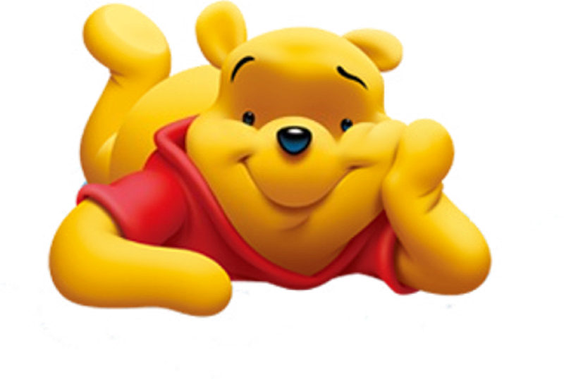
WINNIE THE POOH

